Slide 1
Cisco Certified Network Associate
(CCNA)

Slide 2
Module-4-A Routing

Slide 3
Static Routing

Slide 4
Overview
Explain the significance of static routing
Configure static and default routes
Verify and troubleshoot static and default routes
Identify the classes of routing protocols
Identify distance vector routing protocols
Identify link-state routing protocols
Describe the basic characteristics of common routing protocols
Identify interior gateway protocols
Identify exterior gateway protocols
Enable Routing Information Protocol (RIP) on a router

Slide 5
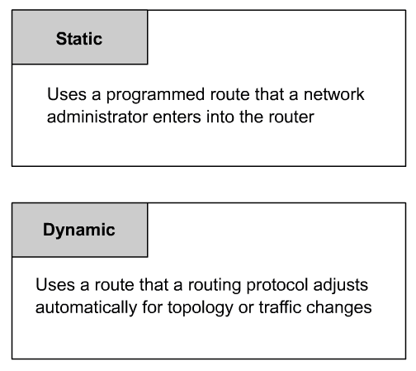
Routing Types

Slide 6
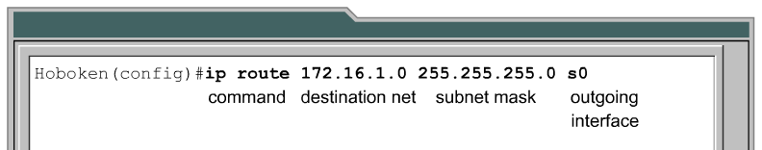
Static Route Operation
Hoboken#show ip route
Codes: C - connected, S - static,
S 172.16.1.0/24 [1/0] is directly connected, Serial0
C 192.168.2.0/24 is directly connected, Ethernet0

Slide 7
ip route command
RTR(config)# ip route prefix mask {address | interface} [distance] [tag tag] [permanent]
prefix IP route prefix for the destination.
mask Prefix mask for the destination.
address IP address of the “next hop” that can be used to reach that network.
interface Network interface to use (exit-interface)
distance (Optional) An administrative distance.
tag tag (Optional) Tag value that can be used as a "match" value for controlling redistribution via route maps. (CCNP Advanced Routing)
Permanent (Optional) Specifies that the route will not be removed, even if the interface shuts down. (CCNP Advanced Routing)

Slide 8
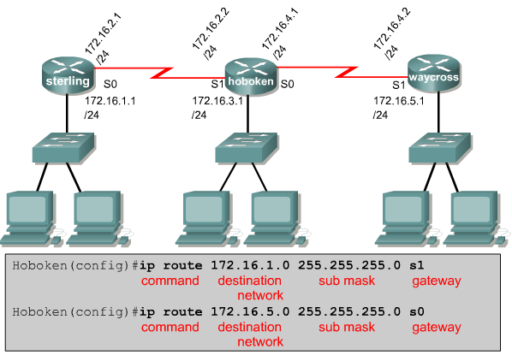
Static Route Operation
If the exit interface (gateway) is “down” the static route will not be put in the routing table.

Slide 9
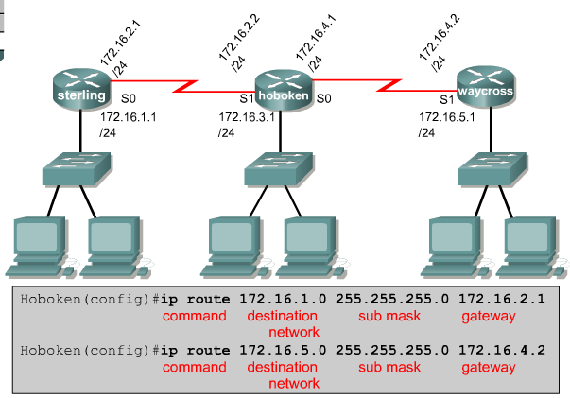
Static Route Operation
If the router cannot reach the outgoing interface that is being used in the route, the route will not be installed in the routing table.
This means if that interface is down, the route will not be placed in the routing table.

Slide 10
Administrative Distance and Metric
Hoboken#show ip route
Codes: C - connected, S - static,
S 172.16.1.0/24 [1/0] is directly connected, Serial0
C 192.168.2.0/24 is directly connected, Ethernet0
[ administrative distance / routing metric (or cost) ]
The cost for all static routes is “0”
The default administrative distance for static routes is “1”

Slide 11
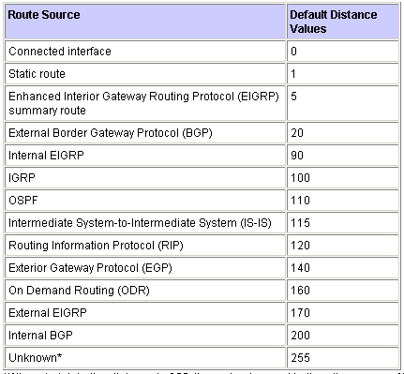
Administrative Distance
Administrative Distance is the “trustworthiness” of the routing information.
Lower the administrative distance the more trustworthy the information.
If the router hears about a route to the same network from more than one source it will use the administrative distance to decide which route to put in the routing table.

Slide 12
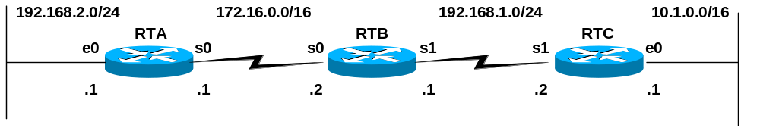
Static Routing
Configuring static routes
Routers do not need to configure static routes for their own directly connected networks.
We need to configure static routes for networks this router needs to reach.
We will need to configure static routes for the other routers as well, as “routing information about a path from one network to another does not provide routing information about the reverse, or return path.”
Convergence – When all the routers in the network (AS) have accurate and consistent information, so that proper routing and packet forwarding can take place.
Convergence will not happen until all the routers have complete and accurate routing information, meaning we must configure static routes on all the routers before packets will be correctly delivered.

Slide 13
Static Routing
RTA(config)#ip route 192.168.1.0 255.255.255.0 172.16.0.2
RTA#show ip route
Codes: C - connected, S - static,
C 172.16.0.0/16 is directly connected, Serial0
S 192.168.1.0/24 [1/0] via 172.16.0.2
C 192.168.2.0/24 is directly connected, Ethernet0
Network/subnet route
Intermediate-Address (usually “next-hop”)
Basic static route example
Be sure to use the proper subnet mask!

Slide 14
Static Routing
RTA(config)#ip route 192.168.1.0 255.255.255.0 172.16.0.2
RTA#show ip route
Codes: C - connected, S - static,
C 172.16.0.0/16 is directly connected, Serial0
S 192.168.1.0/24 [1/0] via 172.16.0.2
C 192.168.2.0/24 is directly connected, Ethernet0
Basic static route example (continued)
[1/0] – [ Administrative Distance / Metric ]
Administrative Distance – This is the “trustworthiness” of the routing information. The default administrative distance of static routes is 1.
The Administrative Distance of a directly connected route is 0.
Lower the AD the more trustworthy.
If the router learns about a route to a network from more than one source, it will install the route with the lower administrative distance in the routing table.

Slide 15
Static Routing
RTA(config)#ip route 192.168.1.0 255.255.255.0 172.16.0.2
RTA#show ip route
Codes: C - connected, S - static,
C 172.16.0.0/16 is directly connected, Serial0
S 192.168.1.0/24 [1/0] via 172.16.0.2
C 192.168.2.0/24 is directly connected, Ethernet0
Basic static route example (continued)
[1/0] – [ Administrative Distance / Metric ]
Metric – This is the “cost” of getting to this route, I.e. how far away this network is.
The lower the cost, the closer the network.
Static routes always show a cost of “0” even if it was configured with the intermediate address is multiple-hops away.
Much more later.

Slide 16
Static Routing
RTA#debug ip routing
IP routing debugging is on
RTA#conf t
Enter configuration commands, one per line. End with CNTL/Z.
RTA(config)#ip route 192.168.1.0 255.255.255.0 172.16.0.2
05:53:48: RT: add 192.168.1.0/24 via 172.16.0.2, static metric [1/0]
RTA(config)#ip route 10.1.0.0 255.255.0.0 172.16.0.2
05:54:38: RT: add 10.1.0.0/16 via 172.16.0.2, static metric [1/0]
RTA(config)#undebug all
Static Routes and the Routing Table Process
Notice that the static route is entered into the routing table by the routing table process (debug ip routing) with a metric of 0.

Slide 17
Static Routing
RTA(config)#ip route 192.168.1.0 255.255.255.0 172.16.0.2
RTA(config)#ip route 10.1.0.0 255.255.0.0 172.16.0.2
RTB(config)#ip route 192.168.2.0 255.255.255.0 172.16.0.1
RTB(config)#ip route 10.1.0.0 255.255.0.0 192.168.1.2
RTC(config)#ip route 192.168.2.0 255.255.255.0 192.168.1.1
RTC(config)#ip route 172.16.0.0 255.255.0.0 192.168.1.1
Configuring all of the static routes
Notice that the intermediate-address is always the next-hop ip address.
This does not always have to be the case, and we will look at other options in the presentation on Static Routes- Additional Information
Good idea to do a “copy running-config startup-config” if everything is working right.
To verify the routes are in there, you can do a:
Router# show running-config

Slide 18
Static Routing
RTA(config)#ip route 192.168.1.0 255.255.255.0 172.16.0.2
RTA(config)#ip route 10.1.0.0 255.255.0.0 172.16.0.2
RTA#show ip route
Codes: C - connected, S - static,
C 172.16.0.0/16 is directly connected, Serial0
10.0.0.0/16 is subnetted, 1 subnets
S 10.1.0.0 [1/0] via 172.16.0.2
S 192.168.1.0/24 [1/0] via 172.16.0.2
C 192.168.2.0/24 is directly connected, Ethernet0
RTA#ping 10.1.0.1
!!!!!
RTA#ping 192.168.1.2
!!!!!
RTA#ping 192.168.1.1
!!!!!

Slide 19
Static Routing – Routing Table Process
RTA#debug ip routing
IP routing debugging is on
RTA#conf t
Enter configuration commands, one per line. End with CNTL/Z.
RTA(config)#ip route 192.168.1.0 255.255.255.0 172.16.0.2
05:53:48: RT: add 192.168.1.0/24 via 172.16.0.2, static metric [1/0]
RTA(config)#ip route 10.1.0.0 255.255.0.0 172.16.0.2
05:54:38: RT: add 10.1.0.0/16 via 172.16.0.2, static metric [1/0]
RTA(config)#undebug all
Static Routes and the Routing Table Process
Notice that the static route is entered into the routing table by the routing table process (debug ip routing) with a metric of 0.

Slide 20
Static Routing – Point-to-Point Links
RTA(config)#ip route 192.168.1.0 255.255.255.0 serial 0
RTA#show ip route
Codes: C - connected, S - static,
C 172.16.0.0/16 is directly connected, Serial0
S 192.168.1.0/24 is directly connected, Serial0
C 192.168.2.0/24 is directly connected, Ethernet0
Need only to use only an exit interface.
For point-to-point serial interfaces, the next-hop address in the routing table is never used by the packet-delivery procedure, so it is not needed. (It could even reference a bogus IP address.)
Notice that the static route appears in the routing table as directly connected, however it is still a static route with an administrative distance of 1.

Slide 21
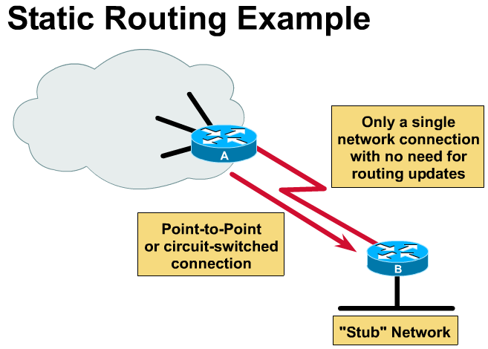
Common uses for Static Routes
Default
10.1.1.1/24
ISP
ip route 172.16.0.0 255.255.0.0 10.1.1.2
10.1.1.2/24
Cabrillo College
ip route 0.0.0.0 0.0.0.0 10.1.1.1
172.16.0.0/16
RTB#show ip route
Gateway of last resort is 10.1.1.1 to network 0.0.0.0
C 172.16.0.0/16 is directly connected, Ethernet0
10.0.0.0/24 is subnetted, 1 subnets
C 10.1.1.0 is directly connected, Serial1
S* 0.0.0.0/0 [1/0] via 10.1.1.1
Any packets not matching the routes 172.16.0.0/16 or 10.1.1.0/24 are sent to the router 10.1.1.1 – where it is now their “problem.”

Slide 22
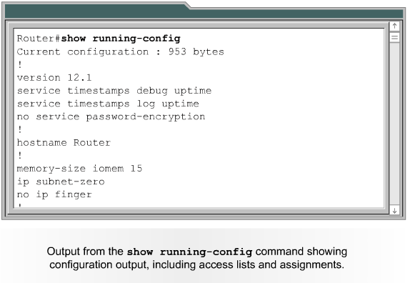
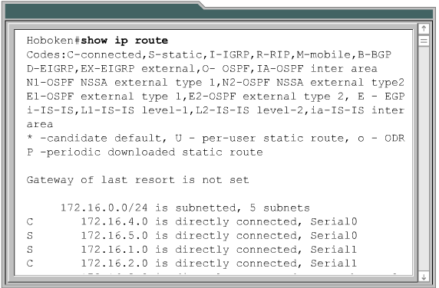
Verify static routes
Copy running-config startup-config

Slide 23
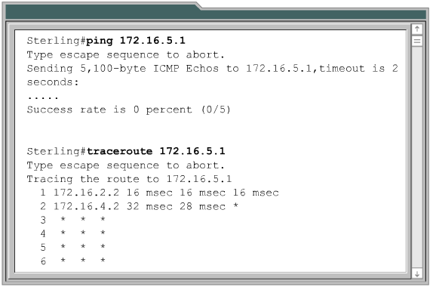
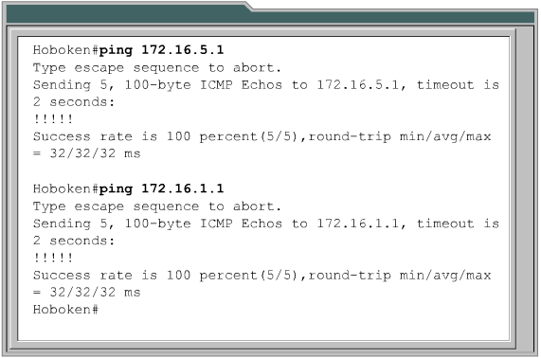
Ping and Trace route to troubleshoot

